Slide 1
LECTURE -01
Fundamentals of Data Analysis
Course Instructor
Engr. Naina Said

Slide 2
What is Data Analysis?

Slide 3

Which Flavor Should I take to the party??

Slide 4


Slide 5
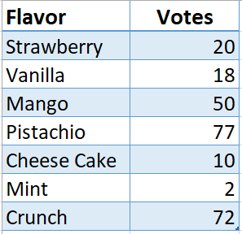
Frequency Distribution Table!

Slide 6
Frequency bar graph!

Slide 7
Data Analytics
Data analytics refers to the process of examining datasets to draw conclusions about the information they contain. Data analytic techniques enable you to take raw data and uncover patterns to extract valuable insights from it.

Slide 8
Fun Fact
Data Analysis comes very naturally to us. Imagine you going to Hunza on a trip with your friends. How would you decide on what clothes you need to pack?

Slide 9
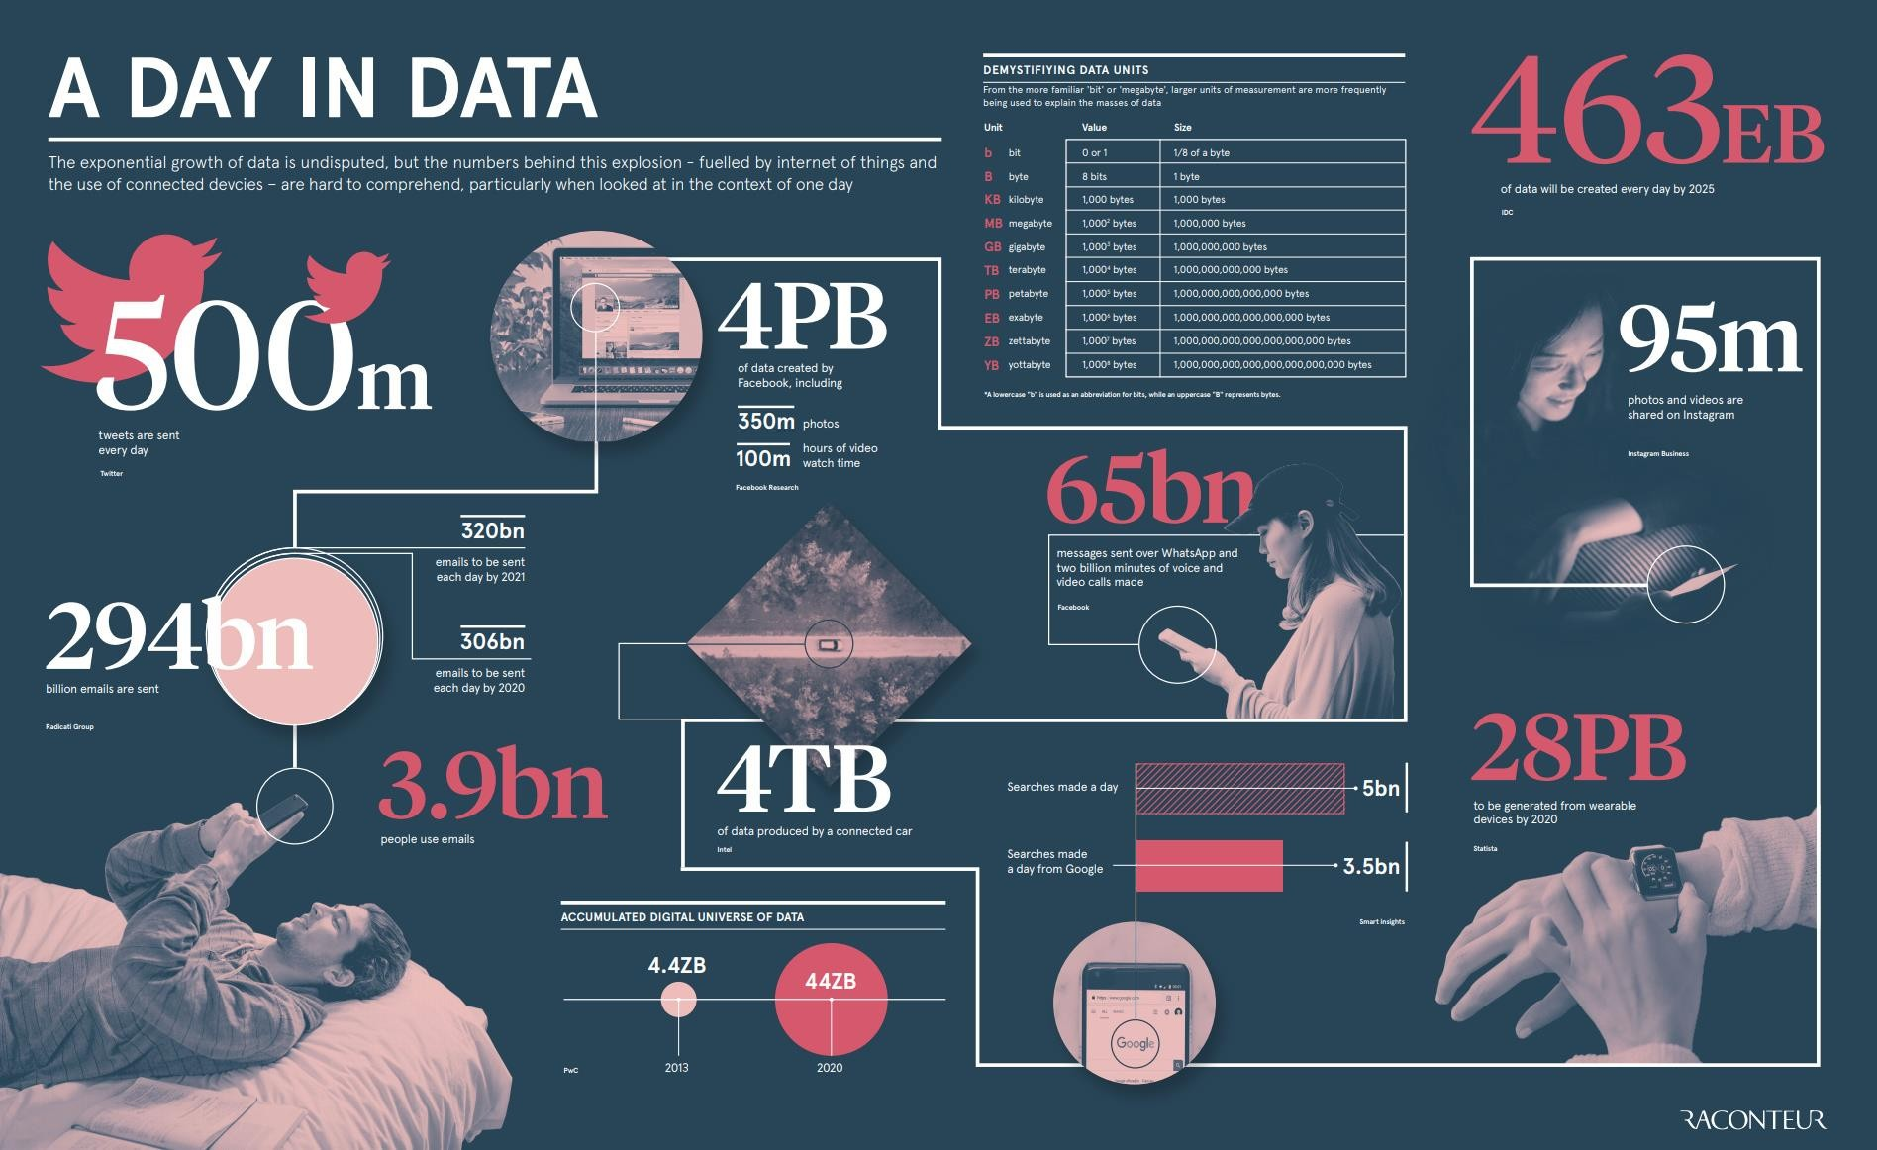

Slide 10
The importance of Data
CSE-422: Data Analytics
Can we do something useful with the enormous amount of data that is generated every minute?
Doing something useful with data = Analysis of data!
Data Analysis requires skilled people who can work with data.

Slide 11
Data Professionals
CSE-422: Data Analytics
With data, our end goal is to improve our decision making and hence profitability.
Various professionals are involved in achieving this goal.
Data Engineers
Data Analysts
Data scientists
Business Analysts
All these people help organizations find actionable insights from the large amount of data.

Slide 12
Data Professionals
CSE-422: Data Analytics
Data engineering converts raw data into usable data.
Data analytics uses this data to generate insights.
Data scientists use data analytics and data engineering to predict the future
using data from the past.
Business analysts and business intelligence analysts use these insights and predictions to drive decisions that benefit and grow their business.

Slide 13
Types of Data Analysis
CSE-422: Data Analytics
Descriptive analytics – What Happened?
It is primarily involved in finding all the statistics that describes the data.
Example: How many buyers bought A.C. in the month of December.
Diagnostic/ Discovery Analytics – Why did it Happen?
Example : Why there is an increase/ decrease in the sales of A.C.in the month
of December?
Predictive Analytics- What will Happen Next?
Example: What shall be the sales improvement next year?
Prescriptive Analytics- What should be done about it?
Example: How much amount of material should be procured to increase the
production?

Slide 14
The Data Analysis Process
CSE-422: Data Analytics
Setting a clear metric
Decide what will be measured and how it will be measured?
Gathering the Data
Identify the data you will require.
The sources where you will get this data and the tools needed.
Cleaning Data
Fix quality issues in the data.
Standardize the data coming from multiple sources.
Analyzing the data
Analyze and manipulate data from different perspectives
Find patterns, trends, correlations etc.

Slide 15
The Data Analysis Process
CSE-422: Data Analytics
Interpreting Results
What does your analysis mean?
Interpretation is important because this is what leads to informed decisions.
Presenting your Findings
Present your findings in clear, impactful and convincing way.
Tell a story!

Slide 16
Data Analytics Applications
CSE-422: Technical Writing

Slide 17
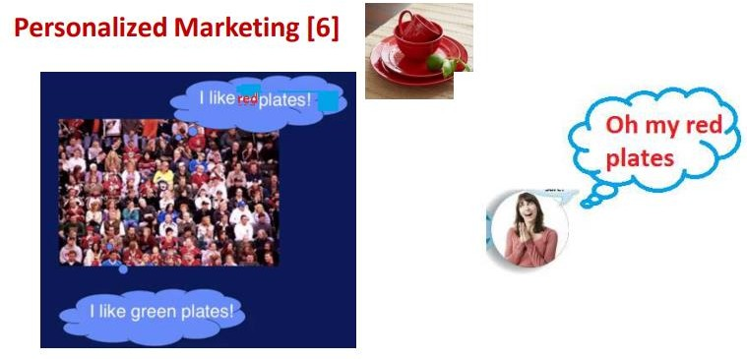
Personalized Marketing
CSE-422: Data Analytics
Many shopping companies use Big Data Analytics for personalized marketing to make their customers happy.
They have Recommendation engines for the same.

Slide 18
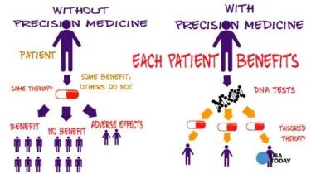
Healthcare
CSE-422: Data Analytics
Precision Medicine
It involves analyzing the patients genetic data, environment, day to day activities, to predict the health problems so that prescriptions can be followed to prevent diseases.
In case a disease is diagnosed, it provides personalized treatment targeting a particular individual to provide the correct composition of medicine in the correct dose.

Slide 19

Smart Data Analytics
CSE-422: Data Analytics
The very huge Smart data from the sensor networks of Smart projects like smart cities, smart homes etc. are analyzed for pollution control, security by preventing from thefts, homicide, energy conservation, traffic maintenance, disaster management and many more.

Slide 20
Finance
CSE-422: Data Analytics
In Finance, Data Analytics can improve the following aspects
Credit Scoring- to find people with highest credit worthiness.
Fraud Detection- to predict fraudulent transactions and customers in the financial services industry and to formulate strategies to prevent or minimize damages from it.

Slide 21
Skills Needed to Become a Data Analyst
CSE-422: Data Analytics
Querying languages, such as SQL, used for accessing and manipulating data from databases.
Analysis tools including Spreadsheets, R-Language, Python, IBM SPSS Statistics.
Visualization tools Spreadsheets, Jupyter Notebook, Python libraries, R-Studio Tableau, and Power BI.

